Slide 1




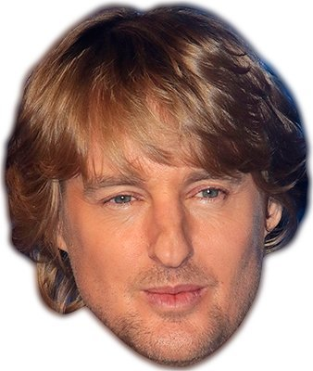


Day 4 – 11:30 Project Progress Report -Tympe-
Logan Schlick, Daniel Marin, Kyle Rimando, Sonny Pizzo, Shane Ghuste

Slide 2


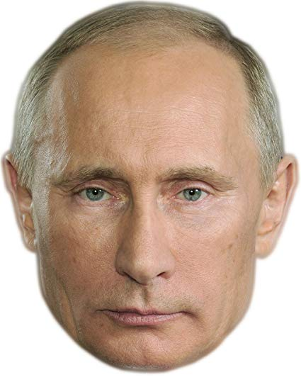
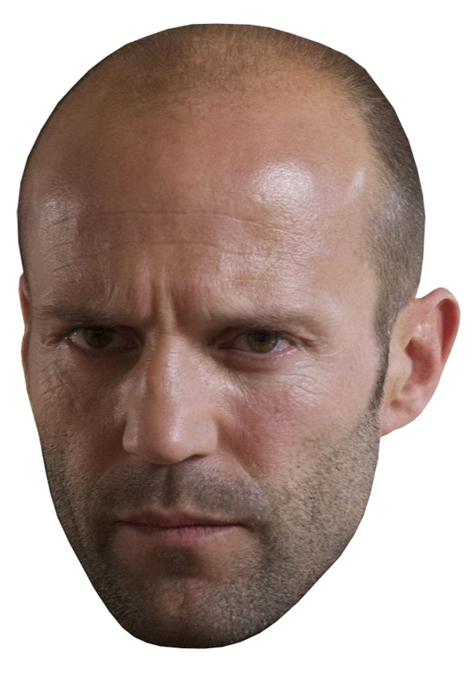


Front end progress…
Finished the layout of all pages and completed look of game.
Might play with it more but for now we are done.
Front end designers:
Daniel Marin
Sonny Pizzo

Slide 3


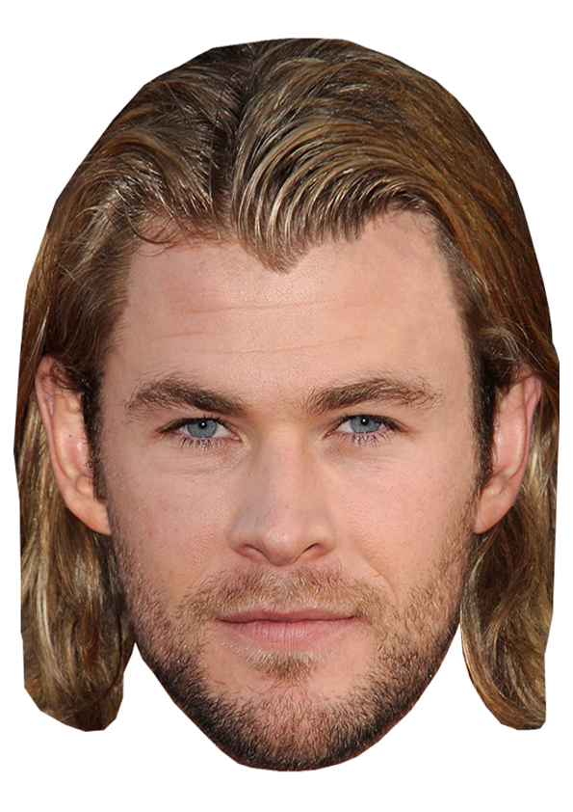
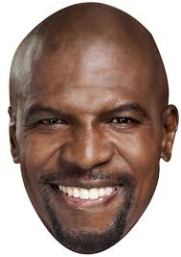


Back end progress…
Finished backend.
Linked everything to form a smooth running game.
Back end designers:
Logan Schlick
Kyle Rimando

Slide 4
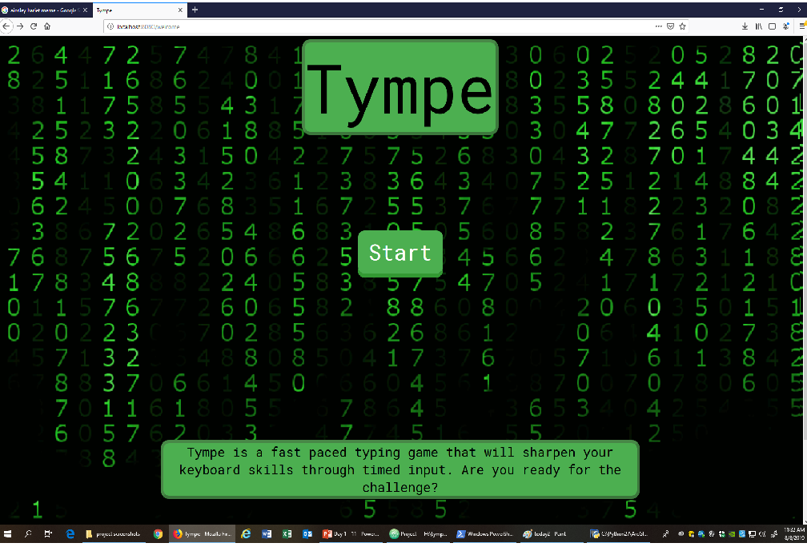
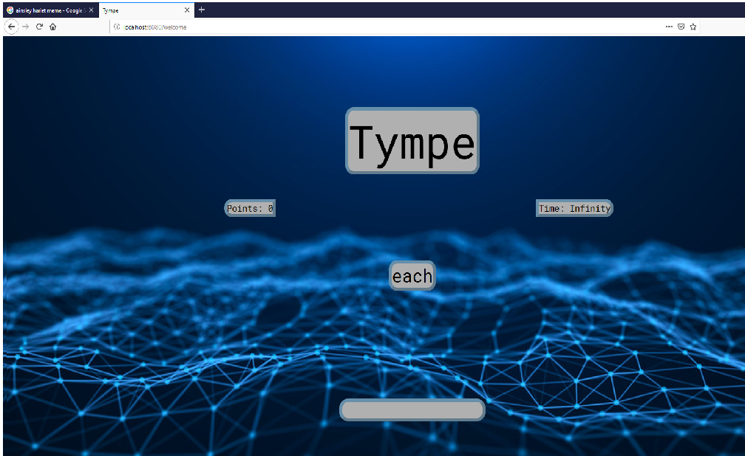
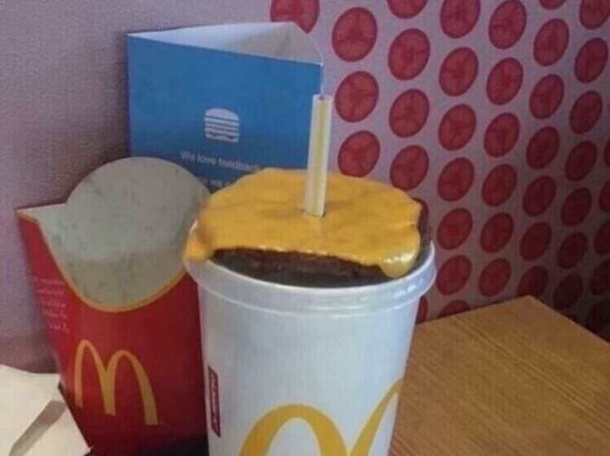
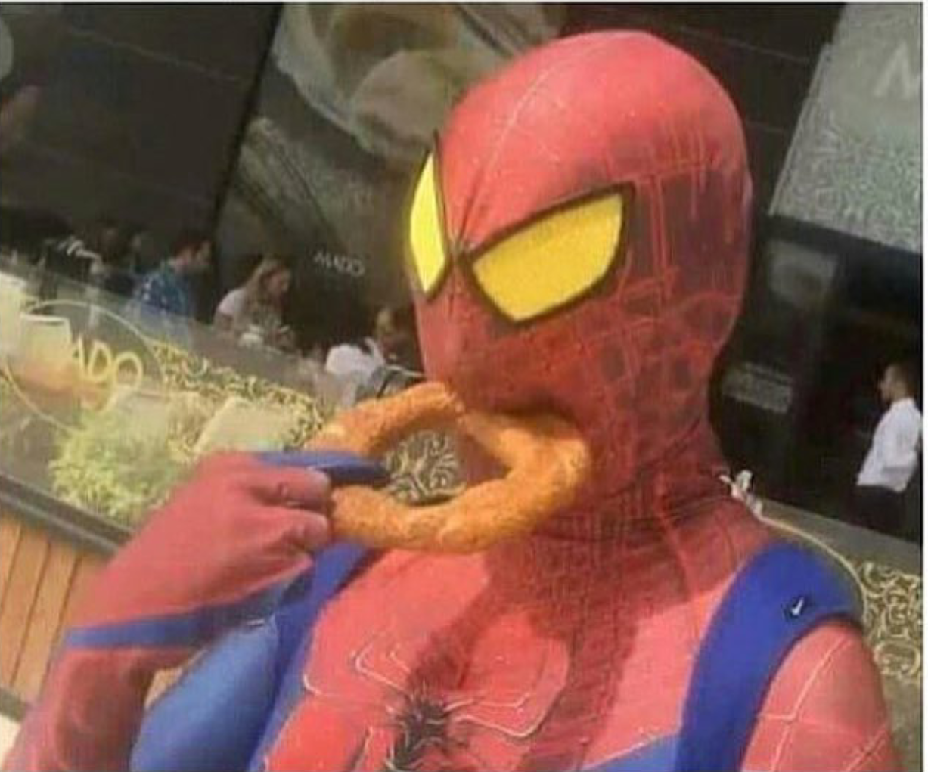

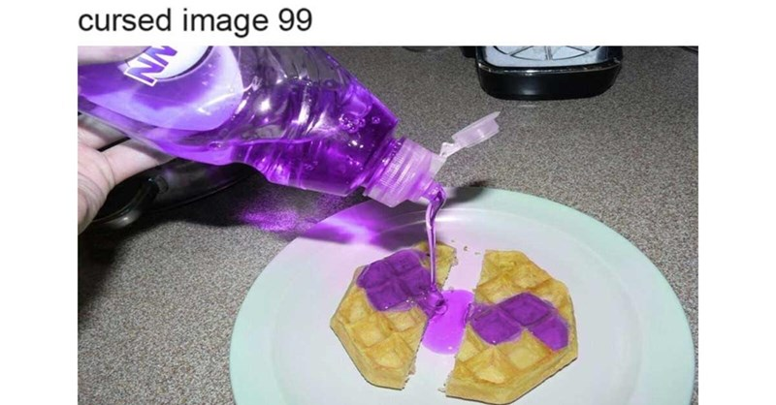
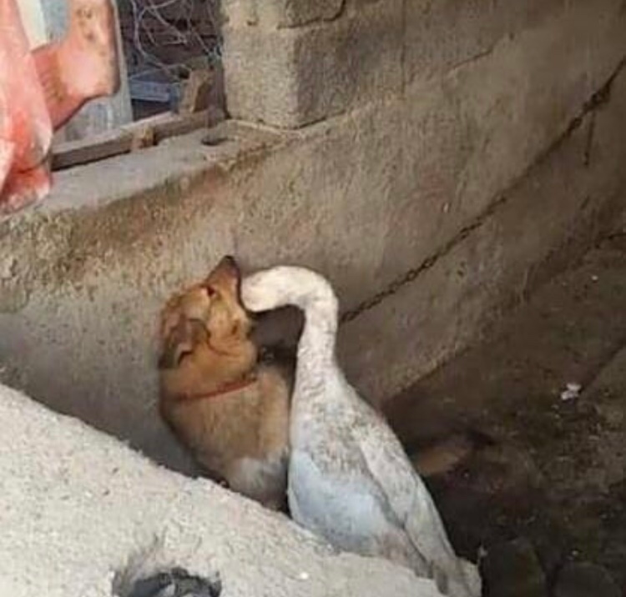

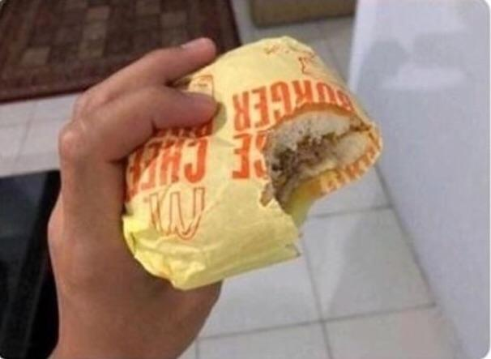
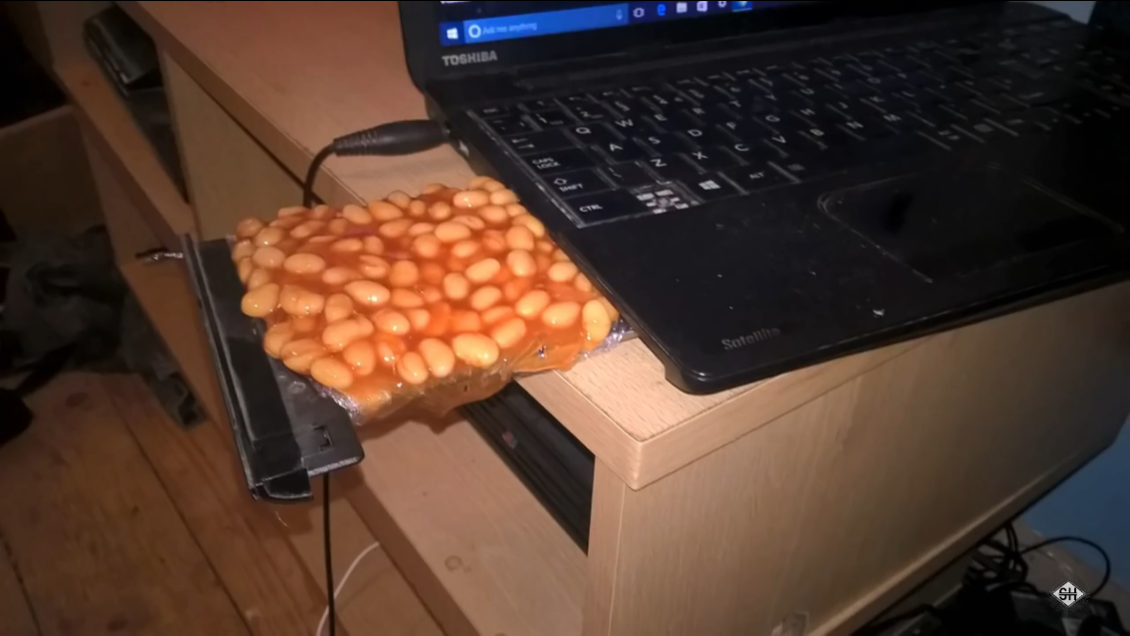
Start page
Game page

